Slide 1
INFO5100 : Application Engineering and Development
Lecture 3 : Multi-Party Relationships?

Slide 2
Foundation of Digital Eco-System Design
Applications most of the time involve more than on party
Amazon platform, Alibaba, Azure, Google eco-system, Apple eco-system
Applications are more of a network of participating entities
A visit to the doctor could turn into visits to other doctors

Slide 3
Specialist clinics have their own network of service providers
Enterprise B
Enterprise A
Pharmacy
Specialist clinic
Primary care physician
Lab
Physical Thereby
Billing
Insurance

Slide 4
Eco-System
(Payment)
Business Units
Enterprise
Business Units
Business Units
Eco-System
(Retail)
Eco-System
(Cyber-Security)

Slide 5
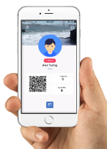
E-com-
merce
Hospitals
Doctors
Pharmacy
Financial
Services
Atlas Digital
Platform
Eco-system
Platform
Services
Insurance
Beauty
Care
Fitness
Health
check ups
Physio
therapy
centers

Slide 6
An Eco-System
A dynamic network of entities (people, businesses and things) interacting with each other to create and exchange sustainable value for participants.
Dynamic
Entities
Self
organizing
Network
Creating
Value
Interactive
Delivering a total system that is greater than the sum of the parts

Slide 7
An Eco-System
A dynamic network of entities (people, businesses and things) interacting with each other to create and exchange sustainable value for participants.
Self
organizing
Entities
Network
Exchange
Creating
Value
Interactive
Delivering a total system that is greater than the sum of the parts

Slide 8
An Eco-System
A dynamic network of entities (people, businesses and things) interacting with each other to create and exchange sustainable value for participants.
Social Value
Industry
Industy
Enterprise
Enterprise
Enterprise
Unit
Unit

Slide 9
Steps
We will start with simple supplier model
And progressively at the end toward
Eco-system engineering method to deliver complete applications made up of many enterprises work together to deliver complex products and services

Slide 10
A Simple Eco-systemproblem
Best Buy wants to build a web application to make it easy for their customers to browse and lean more about all their products
Combined product offerings
Dell products
Product 2
Product 3
Toshiba
Sony

Slide 11
Who are the players?

Slide 12
Best Buy sells products from multiple suppliers
Best Buy
Dell
HP
Toshiba
IBM
Sony

Slide 13
Best Buy wants each supplier to manage their own catalog of products
Dell
Laptop 101
Dell Server
Dell Switch 902
Desktop 200
Storage Server

Slide 14
Best Buy will register each supplier first and from then on each supplier must keep its product catalog up to date.
1
Register Suppliers
Best Buy
Dell
HP
Toshiba
IBM
Sony
2
Manage Own Product Catalog
Dell
Laptop 101
Dell Server
Dell Switch 902
Desktop 200
Storage Server

Slide 15
What do we know so far?
Dell
Best Buy Supplier Directory
Dell
Dell
Dell
Dell Product
Dell Product Catalog
Dell Product
Dell Product
Dell Product

Slide 16
Each supplier offers many products
Dell
Dell
Dell
Dell
Dell Product
Dell Product
Dell Product
Dell Product

Slide 17
Best Buy has many suppliers Each supplier offers many products
Dell
Best Buy Supplier Directory
Dell
Dell
Dell
Dell Product
Dell Product
Dell Product
Dell Product

Slide 18
Suppliers represented as a directoy Products represented as a catalog
Dell
Best Buy Supplier Directory
Dell
Dell
Dell
Dell Product
Dell Product Catalog
Dell Product
Dell Product
Dell Product

Slide 19
Hierarchy Structure
Supplier Directory
Toshiba
Satellite 100
TECRA 6500
Best Buy
Supplier(s)
Product(s)
Sony
Dell
IBM
What is a higher level component?
What would be a lower level component?

Slide 20
The Business Model
The supplier directory has many suppliers
Supplier Directory
Supplier
A supplier has one product catalog
Product Catalog
Product
The catalog has many products

Slide 21
Hierarchy Structure Example
COE
IS
INFO 5001
INFO 5100
College
Department
Courses
ECE
Civil
MIE
What is a higher level component?
What would be a lower level component?

Slide 22
Hierarchy Structure Example
Travel Agency
JetBlue
Airbus x30-1
Airbus x40-10
Expedia
Airliner (supplier)
Aircraft
Georgian Airways
Air China
Air India
What is a higher level component?
What would be a lower level component?

Slide 23
Other patterns
College
Department
Course Catalog
Course

Slide 24
Other patterns
Travel Agency
Participating Airlines
Airliner
Aircraft

Slide 25
Other patterns
Travel Agency
Customer Directory
Participating Airlines
Airliner
Person

Slide 26
Other patterns
Travel Agency
Customer Directory
Participating Airlines
Fleet
(catalog)
Airliner
Person
Flight Schedule
(Catalog)
Airplane
Flight
Seat

Slide 27
Airliner
Travel Agency
Travel Office
Master Travel Schedule
Customer Directory
Fleet
Flight Schedule
Person
Airplane
Flight
Seat

Slide 28
Other patterns
Supplier
Best Buy
Store
Customer Directory
Product Catalog
Inventory Catalog
Person
Product
Item Inventory
Order

Slide 29
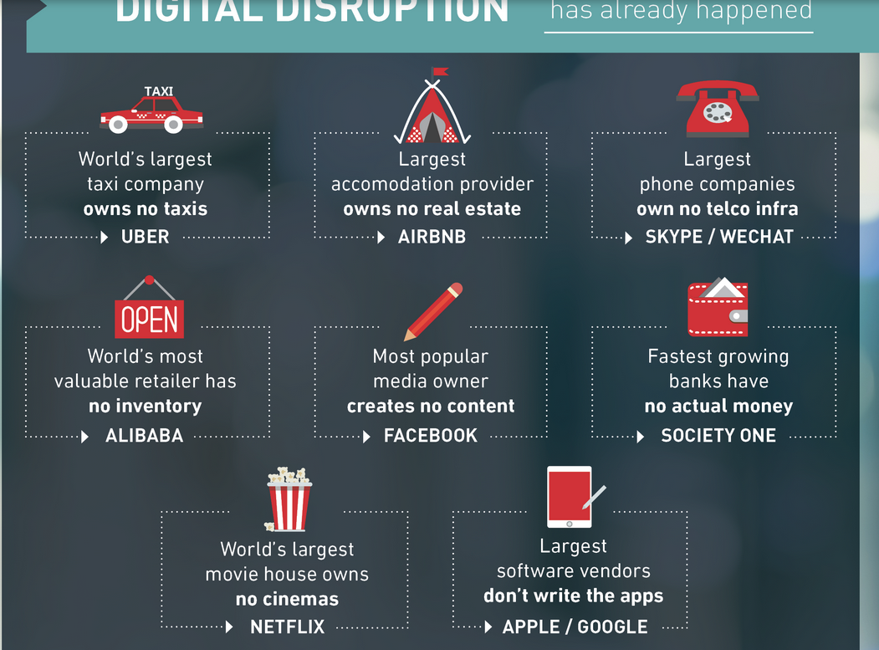

Slide 30
Crew
Airplane crew
Departure time
Destination
Next Maintenance date
Model and serial numbers
Seat status
Find fight to location (e.g., london)
Passenger Capacity
Fuel Capacity
Find cheap flight to London (on xmas eve please)
Schedule a tour around the world (including a 2 day stop in Disneyland)
From destination
All the company’s airplanes that need maintenance soon
Cancel my travel plan
Who are the top 10 best travellers
Create promotion for a exotics trip to South Africa

Slide 31
Implementation

Slide 32
Approach
Manage a supplier database
Add a supplier
Update a supplier
Remove/Disable a supplier
Manage product catalog
Add product
Remove product
Update a product

Slide 33
Manage Suppliers Use Case
System displays admin work area identifying the admin name
System offers two options: view or browse supplier directory
User chooses to view or browse supplier directory
System displays supplier directory
User chooses to:
Add a supplier and returns to previous screen
To view a supplier in detail
Upon viewing a supplier, the user might choose to update the supplier information

Slide 34
Supplier Use Case
Supplier logs in using supplier name
System checks if the supplier is valid and if successful displays supplier work area identifying the supplier name
Supplier chooses to view or browse product catalog
System displays product catalog
User chooses to:
Adds a product and returns to previous screen
User adds a product and returns to previous screen
To view a product in detail
Upon viewing a product, the user might choose to update it

Slide 35
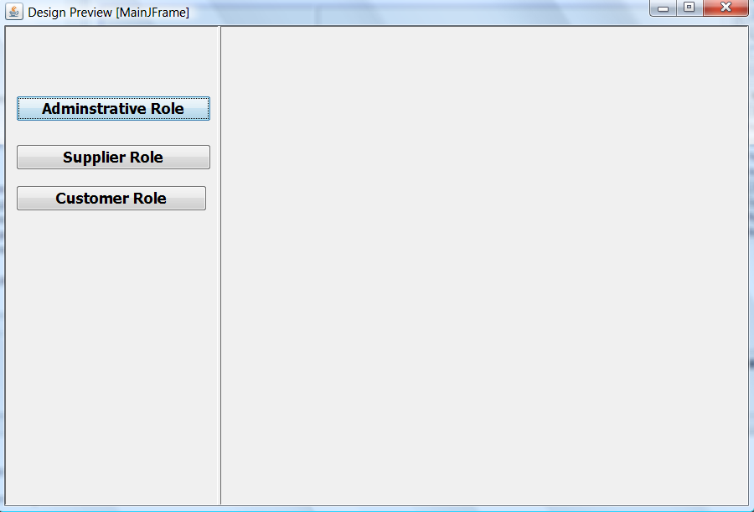
Input: SupplierDirectory

Slide 36
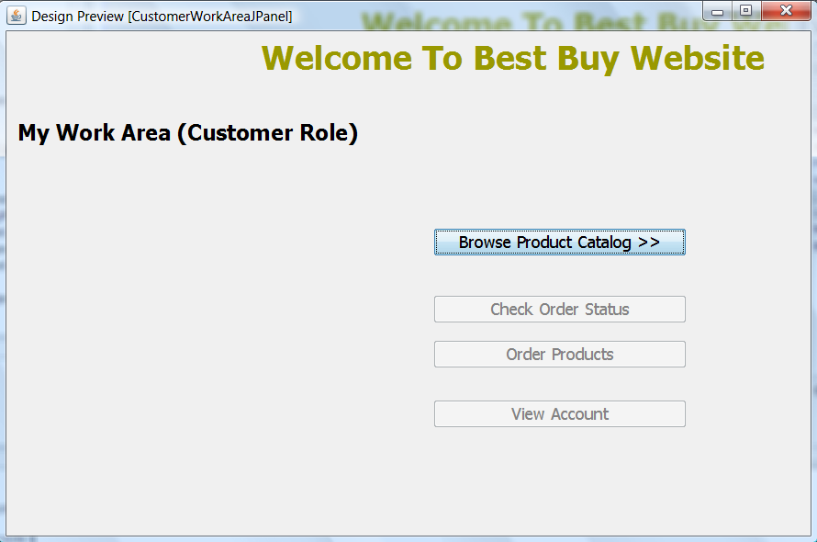
Input: SupplierDirectory

Slide 37
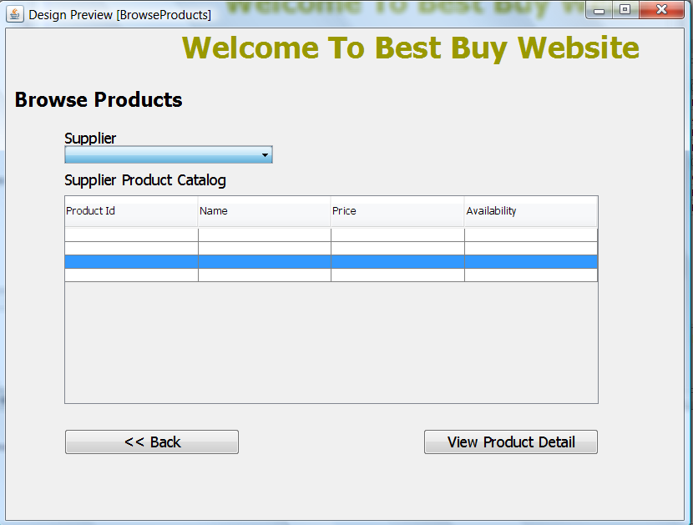
Input: SupplierDirectory

Slide 38
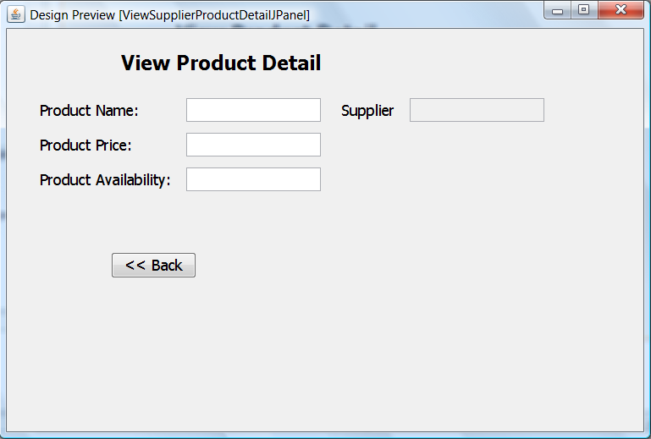
What is the input to this screen?

Slide 39
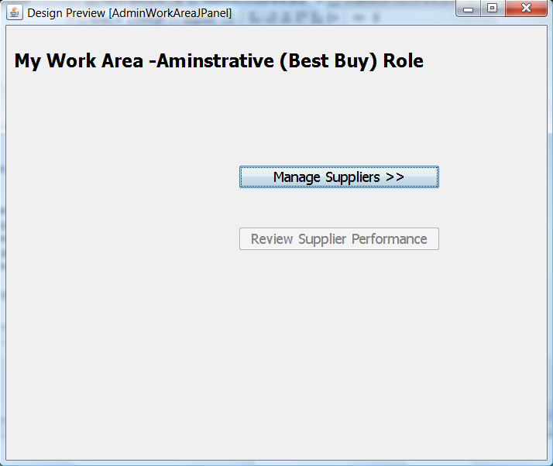
Input: SupplierDirectory

Slide 40
Input: SupplierDirectory

Slide 41
Input: SupplierDirectory

Slide 42
What is the input to this screen?

